Slide 1
Office Computer Application WEEK EIGHT
Muhammad Unggul Pamenang

Slide 2
Please Do It With MS PowerPoint from 2010 - 2016

Slide 3
Tables
1
MS PowerPoint 2016

Slide 4
Introduction
Tables are another tool you can use to display information in PowerPoint. A table is a grid of cells arranged in rows and columns. Tables are useful for various tasks, including presenting text information and numerical data. You can even customize tables to fit your presentation.

Slide 5
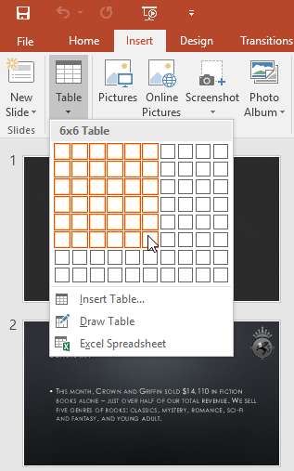
To insert a table:
From the Insert tab, click the Table command.
Hover the mouse over the grid of squares to select the desired number of columns and rows in the table. In our example, we'll insert a table with six rows and six columns (6x6).

Slide 6
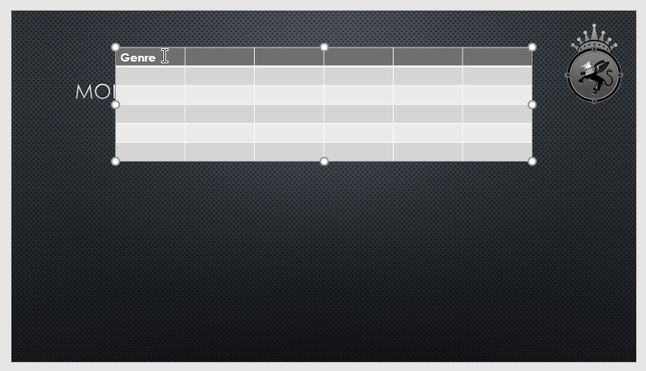
To insert a table:
The table will appear on the currently selected slide. In our example, that's slide 3.
Click anywhere in the table, and begin typing to add text. You can also use the Tab key or the arrow keys on your keyboard to navigate through the table.

Slide 7
Modifying tables
PowerPoint includes several options for customizing tables, including moving and resizing, as well as adding rows and columns.

Slide 8
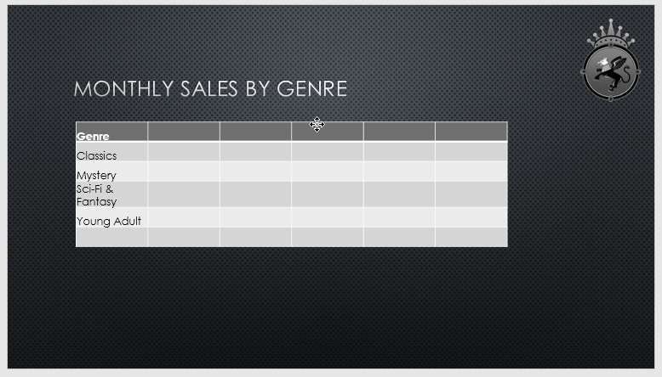
To move a table:
Click and drag the edge of a table to move it to a new location on a slide.

Slide 9
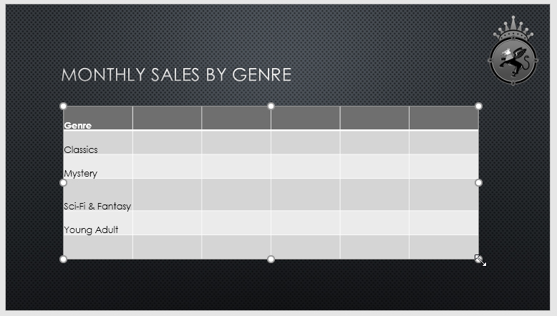
To resize a table:
Click and drag the sizing handles until the table is the desired size.

Slide 10
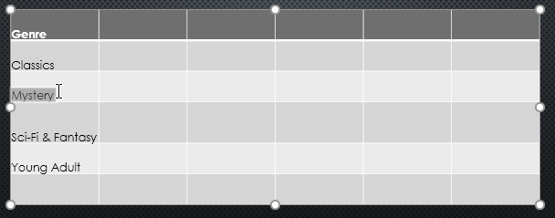
To add a row or column:
Click a cell adjacent to the location where you want to add a row or column. In our example, we'll select the cell that says Mystery.

Slide 11
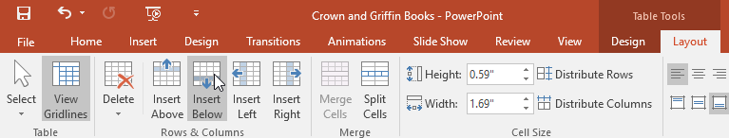
To add a row or column:
Click the Layout tab on the right side of the Ribbon.
Locate the Rows & Columns group. If you want to insert a new row, select either Insert Above or Insert Below. If you want to insert a new column, select either Insert Left or Insert Right.

Slide 12
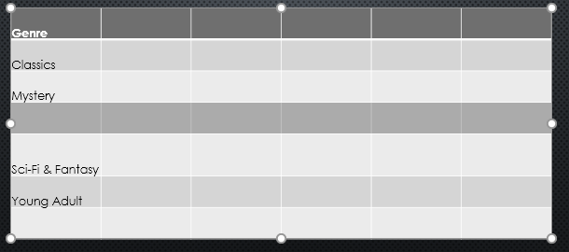
To add a row or column:
The new row or column will appear.

Slide 13
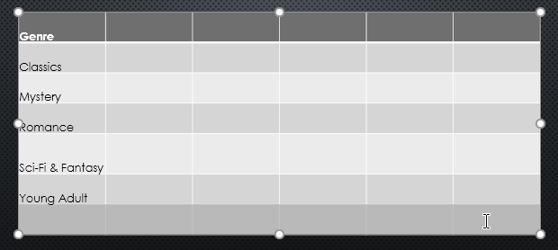
To delete a row or column:
Select the desired row or column. In our example, we'll select the empty row at the bottom of the table.

Slide 14
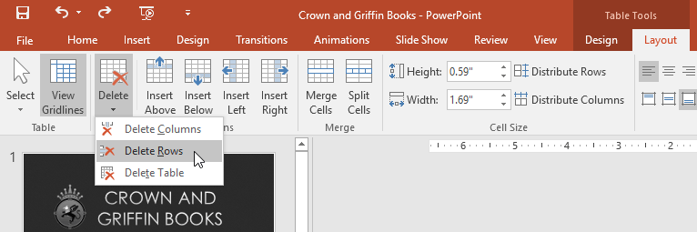
To delete a row or column:
From the Layout tab in the Rows & Columns group, click the Delete command, then select Delete Rows or Delete Columns from the menu.

Slide 15
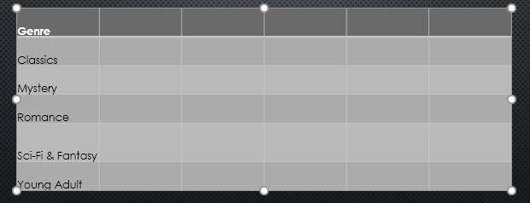
To delete a row or column:
The selected row or column will be deleted.

Slide 16
To delete a table:
Click the edge of the table you want to delete, then press the Backspace or Delete key on your keyboard.

Slide 17
Modifying tables with the Layout tab
When you select a table, the Design and Layout tabs will appear on the right side of the Ribbon. You can make a variety of changes to a table using the commands on the Layout tab.

Slide 18
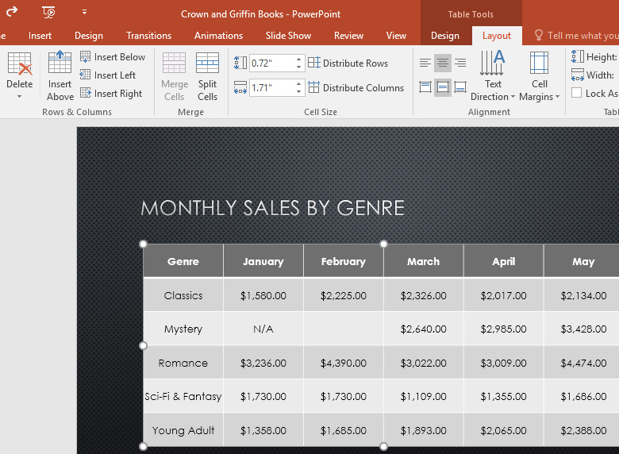
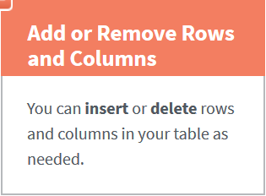
Modifying tables with the Layout tab

Slide 19
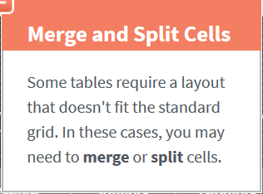
Modifying tables with the Layout tab

Slide 20
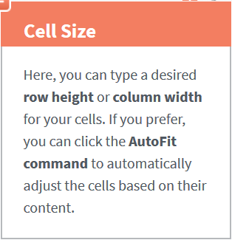
Modifying tables with the Layout tab

Slide 21
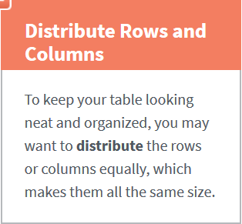
Modifying tables with the Layout tab

Slide 22
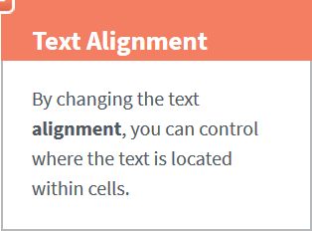
Modifying tables with the Layout tab

Slide 23
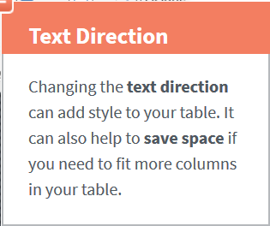
Modifying tables with the Layout tab

Slide 24
Customizing tables
PowerPoint makes it easy to change the look and feel of your tables. For example, you can quickly apply different table styles and customize the table borders.

Slide 25
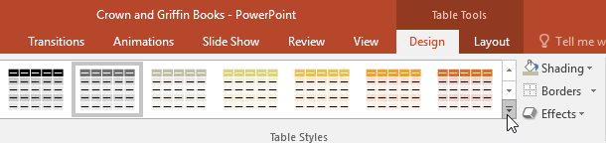
To apply a table style:
Select any cell in your table, then click the Design tab on the right side of the Ribbon.
Locate the Table Styles group, then click the More drop-down arrow to see available table styles.

Slide 26
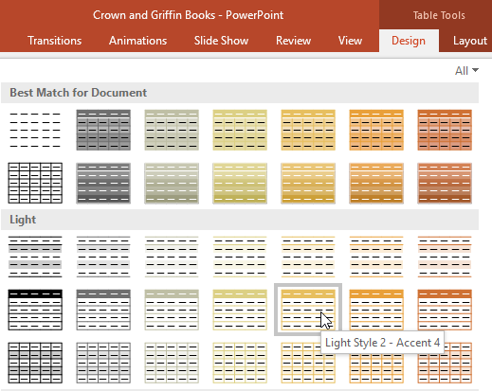
To apply a table style:
Select the desired style.

Slide 27
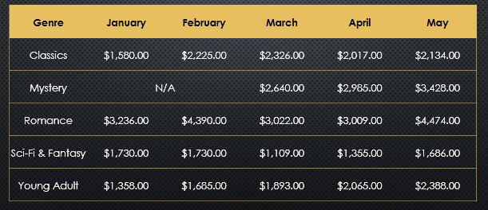
To apply a table style:
The selected table style will be applied.

Slide 28
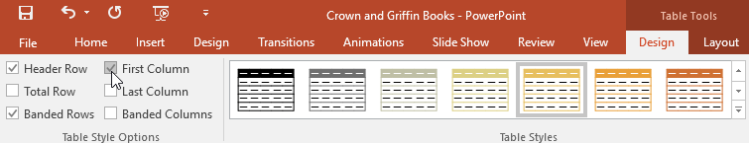
To change table style options:
You can turn various options on or off to change the appearance of the table. There are six options: Header Row, Total Row, Banded Rows, First Column, Last Column, and Banded Columns.
Select any cell in your table.
From the Design tab, check or uncheck the desired options in the Table Style Options group.

Slide 29
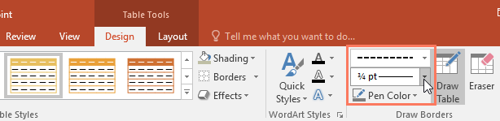
To add borders to a table:
You can add borders to help define different sections of a table. Certain table styles may include borders automatically, but it's easy to add them manually or customize them. You can control the border weight, color, and line style for some or all of a table.
Select the cells where you want to add borders. In our example, we'll select every cell in our table.
From the Design tab, select the desired Line Style, Line Weight, and Pen Color.

Slide 30
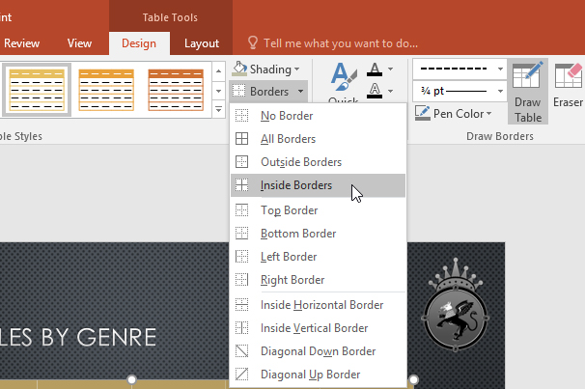
To add borders to a table:
Click the Borders drop-down arrow, then select the desired border type.

Slide 31
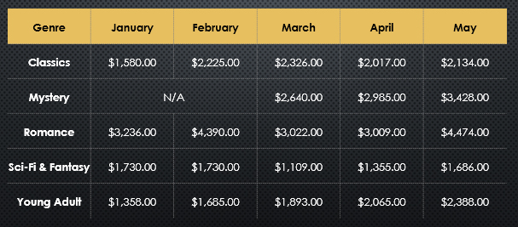
To add borders to a table:
The border will be added to the selected cells.
To remove borders, select the desired cells, click the Borders command, and select No Border.

Slide 32
JOBSHEET
Continue working

Slide 33
THANKS!

